Slide 1
Micro ORM

Slide 2
Why Micro ORM?
Fast
Lightweight
Easy to learn

Slide 3
Dapper.Net
Extends IDbConnection interface
Key feature is performance
NuGet library

Slide 4
Dapper Helpers
Execute query and map the results to strongly typed List
Execute query and map it to a list of dynamic objects
Execute a command that returns no results
Execute a command multiple times

Slide 5
Limitations of Dapper
Dapper doesn’t manage your connection’s lifecycle, it assumes the connection it gets is open.
Many features that ORM ship with are stripped out. No identity map, no built-in insert/update helpers.

Slide 6
Dapper extensions
Dapper Extensions is a small library that complements Dapper by adding basic CRUD operations (Get, Insert, Update, Delete) for your POCOs. For more advanced querying scenarios, Dapper Extensions provides a predicate system. The goal of this library is to keep your POCOs pure by not requiring any attributes or base class inheritance.

Slide 7
Naming conventions
POCO names should match the table name in the database. Pluralized table names are supported through the PlurizedAutoClassMapper.
POCO property names should match each column name in the table.
By convention, the primary key should be named Id. Using another name is supported through custom mappings.

Slide 8
Time for Demo

Slide 9
Simple.Data
Simple.Data is a lightweight framework that uses the dynamic features of .NET 4 to provide an expressive, ORM-ish way of accessing and manipulating data without any of the code pre-generation and boilerplate required by other frameworks. Instead, it interprets method and property names at runtime and maps them to your underlying data-store using a convention-based approach.

Slide 10
Supported Databases
SQL Server 2005 and later
Oracle
MySql 4.0 and later
PostgreSQL
Microsoft Access
MOngoDb

Slide 11
Requirements and Depedencies
Requirements: v4.0 or greater of the .NET framework, or v2.10 or greater of the Mono framework
Dependencies Simple.Data.Core A Simple.Data adaptor A Simple.Data provider (as appropriate)

Slide 12
Configuration
Default: <configuration> <connectionStrings> <add name="Simple.Data.Properties.Settings.DefaultConnectionString“ connectionString="--Your connection string--" /> </connectionStrings> </configuration>>
Named: <configuration> <connectionStrings> <add name="MvcMusicStoreDB“ connectionString="--Your connection string" /> </connectionStrings> </configuration>

Slide 13
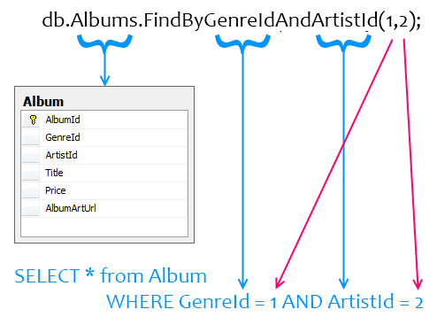
Naming Conventions

Slide 14
Time for Demo

Slide 15
SQL Injection
Based on ""="" is Always True
Based on Batched SQL Statements

Slide 16
Questions

